Slide 1
Practical Messaging
A 101 guide to messaging
Ian Cooper
Twitter: ICooper

Slide 2
Who are you?
Software Developer for over 20 years
Worked mainly for ISVs
Reuters, SunGard, Misys, Huddle
Worked for a couple of MIS departments
DTI, Beazley
Microsoft MVP for C#
Interested in OO design
Interested in Agile methodologies and practices
No smart guys
Just the guys in this room

Slide 3
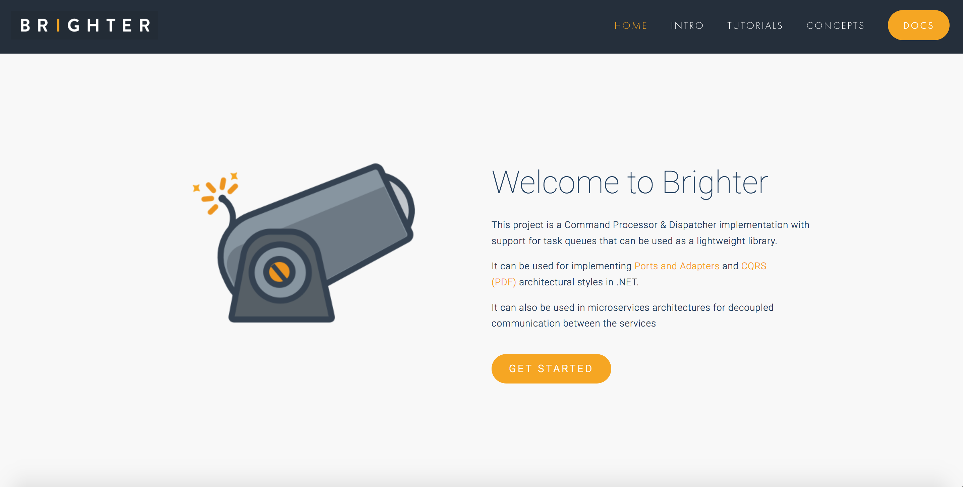

Slide 4
Day One Agenda
Microservices
Integration Styles
Request Driven Architectures
Event Driven Architectures
Messaging Patterns

Slide 5
When do you get to write code?
When we get to messaging patterns, hopefully by the afternoon of Day One and then into the morning of Day Two

Slide 6
Prerequisites
We will use Rabbit MQ for examples. Either you need to have RMQ installed on your machine, or you should have Docker installed on your machine, as exercises provide a Docker Compose file to spin up RMQ.
You will need to be able to author C#, Python, or JavaScript with an editor/IDE of your choice.
You will need Python 3, .NET Core, or ES6

Slide 7
Exercise Code
https://github.com/iancooper/Practical-Messaging-Sharp
https://github.com/iancooper/Practical-Messaging-Python
https://github.com/iancooper/Practical-Messaging-JavaScript

Slide 8
Day One

Slide 9
1.Microservices
What is driving messaging

Slide 10
It’s all about velocity!!!
“Speed wins in the marketplace”
Adrian Cockcroft, former lead architect at Netflix
Notes:
Adrian points out that Continuous Delivery is now “table stakes” for digital companies. You can no longer beat the competition if you have a slow release schedule. We want to ship features as soon as they are done, done! Anything else is inventory waste.
To achieve that, we are going to have to build microservices, once we get beyond a single “two-pizza” team
Although microservices offer a range of benefits, the focus of this deck is how alignment with business capabilities gives us greater productivity, which is the justification for expenditure on the effort required to partition a system into microservices.

Slide 11
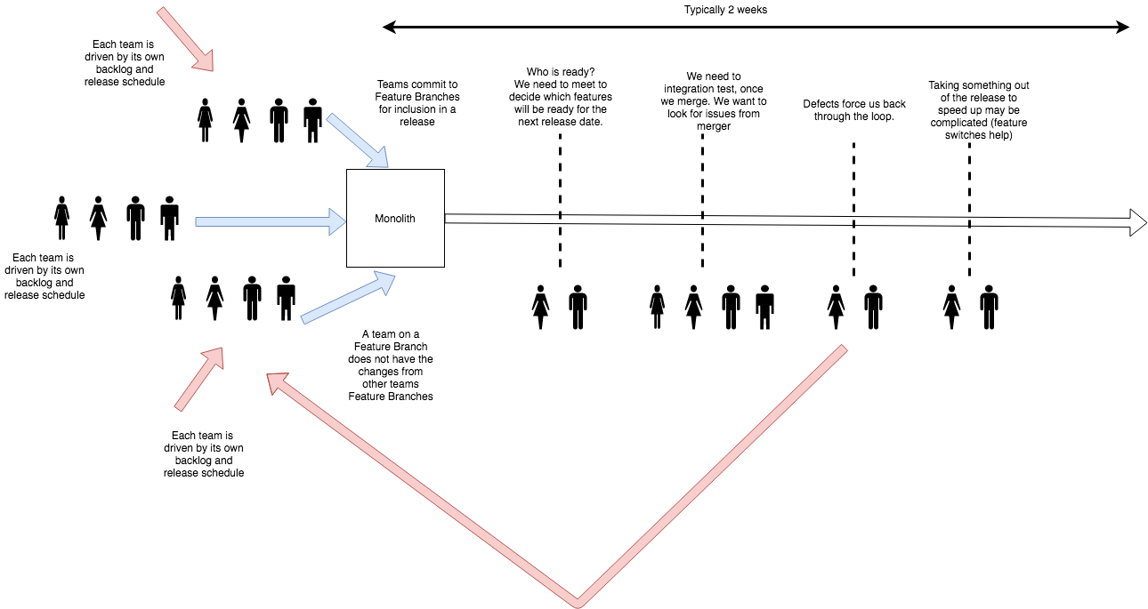
Monoliths Do Not Scale To Many Teams!
Notes:
Monoliths suffer when an organization grows to many teams. Each team has its own backlog, and to avoid contention with other teams changes will branch the repository. When they wish to release, they need to agree with other teams that they will release on a given date, and merge their branch in. Frequently this collides with other teams release schedules, and rather than queue behind each other, they go together. This is because the teams in the rear will have to merge any upstream changes and regression test, before they can release, so to avoid this cost they tend to jump onto the release.
Once all the teams that will join the release are lined up, they merge into the master branch. We then resolve all the conflicts.
More features means more bugs, means greater cost and schedule overruns. If we assume a 30% rework cost, then 30% of 10 days development is 3 days overrun, of 2 days is ½ day.
We must then re-test everything because we have merged potentially incompatible changes.
All the teams now wait on any fixes, even if they belong to another team.
We may be able to drop their changes safely, due to a feature switch, but this can be difficult where they have database changes (a monolith has a shared schema).
Eventually, everyone is ready and we can release, but typically this process takes a couple of weeks. It distracts teams from day-to-day work.
Rollback is also complicated, because we force everyone out. Feature switches and ‘no rollback only roll forward’ become frequent issues.

Slide 12
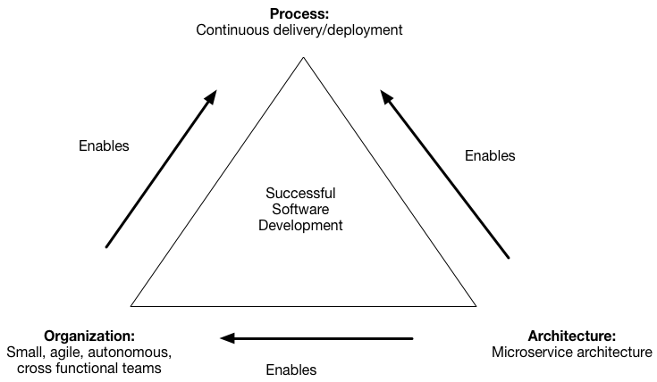
Microservices enable agility
https://microservices.io/patterns/decomposition/decompose-by-business-capability.html
Notes:
This creates a triangle for virtuous software development. Microservices enable small, autonomous teams, who can practice continuous delivery.
Architecture is often an enabler for agile software delivery. You can’t be agile unless your engineering practices support agile delivery. Assuming that we want the benefits of agility (risk reduction through timely feedback, ability to change direction, etc.) we need to use architecture to enable that.
Microservices are a key to unlocking the door of agile at scale, because they let us break up an enterprise a series of small teams, where methodologies like XP and Crystal Clear work. In other words we scale agile, by breaking up the organisation into agile sized units. This doesn’t work if you have a monolith, you will instead be pushed into phased delivery models at scale.

Slide 13
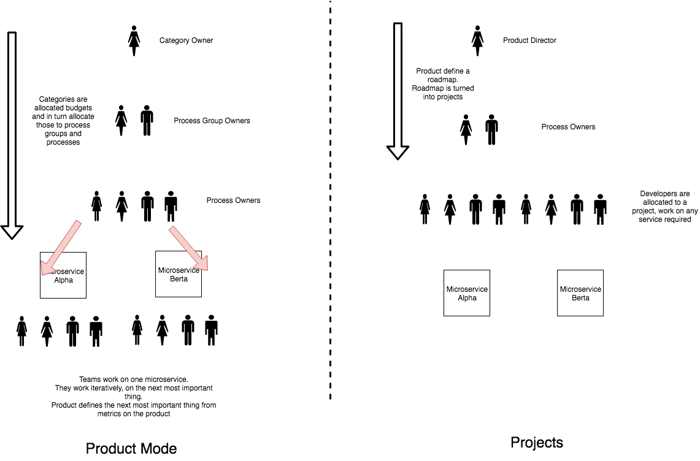
Product Mode
Notes:
In Product mode we allocate resources to products, with a backlog of work for that product, and deliver in an incremental and iterative fashion. There is no end date. Prioritisation is by next highest item. Success is defined by improvement of a metric aligned to a business outcome.
For microservices this means allocating resources to a process, with a backlog of work for that process, which we can deliver on in an incremental and iterative fashion.
In project mode we organise around an item of work that has an end date. Teams work across multiple services to deliver the requirements of the project. Projects are more waterfall than agile as they have significant up-front requirements, and tend to have a long-tail of QA when all the parts must be integrated. Success is defined by ‘keeping to the plan.’ As such projects often conflict with agile methods.
In project mode we have project managers, in product mode we have product owners.

Slide 14
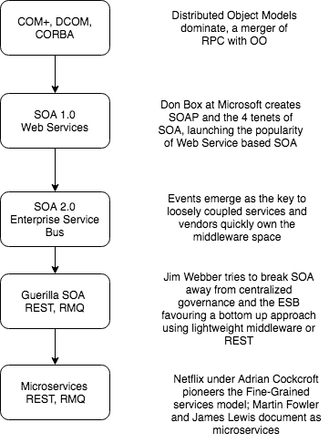
A Brief History of Microservices
The definition of Microservices, we use comes from the paper by Martin Fowler and James Lewis
Notes:
Microservices are really an iteration of SOA, with the vendor control removed, and a focus on loose coupling. Why is this important? Because there is a lot of significant guidance from SOA that is applicable to Microservices, and many operate without knowing that when a microservice document refers to concepts such as ‘business capability’ it means something specific, that has meaning to those who have an SOA background.
So when we talk about microservices there are some things we do not mean, particularly API based services or Entity based services

Slide 15
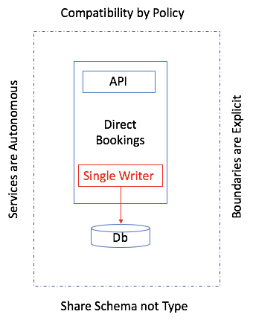
Microservices are partitions of software
Notes:
A microservice is a partition of our monolith that is roughly team-sized in scope and complexity. A microservice needs to be released autonomously, so that we do not have dependencies on other teams for release. This creates the need for the microservice to adhere to the 4 tenets of SOA:
Services are Autonomous: We can be released independently of any other service. This is our goal. It is why we can’t share a Db table for example.
Boundaries are Explicit: We cannot allow other teams to couple to our implementation details, as we want to change these without impacting downstream consumers. So we only interop via a defined contract to an abstraction such as an API or messages, and do not couple to our details. Consumers depend on abstractions, not details
Share Schema not Type: We don’t want to make assumptions about support for a type system in downstream consumers, such as sharing a .NET assembly
Compatibility is by Policy: We adhere to standards such as OpenID to allow us to call our APIs

Slide 16
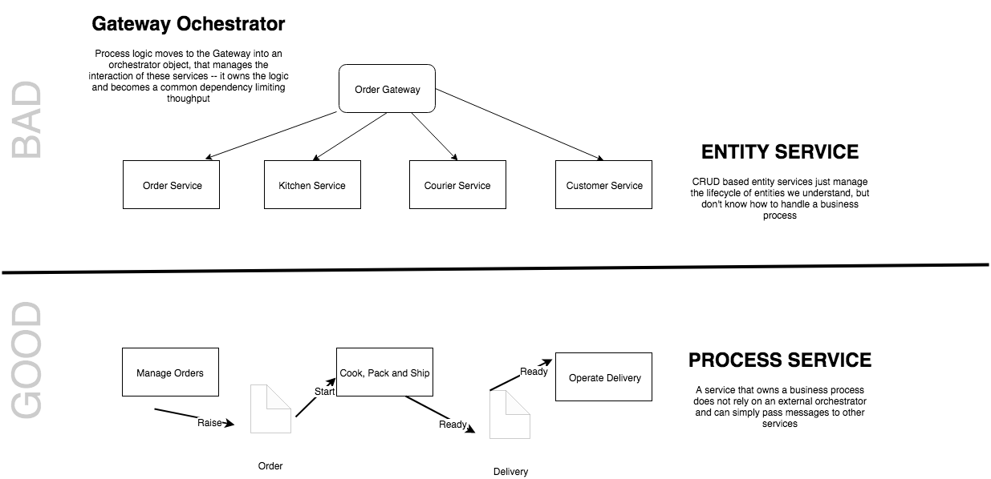
The Entity Service Sniff Test
See Avoiding the Entity Service, Michael Nygard
Notes:
We need to be cautious of modeling microservices by looking for entities in our system and wrapping them with an API. This model tends to result in ‘feature envy’ as the business process logic creeps out of the service and into a Gateway orchestrator. Often this creates temporally coupled services, or the need to copy a lot of data in projections between services. By focusing on a process we can make our services more self-contained and more effectively use messaging to communicate.
Sometimes things just are an entity service, but they tend to be sources of reference data cached locally by other services to do their work

Slide 17
What is a microservice?
SOA is focused on business processes. These processes are performed in different steps (also called activities or tasks) on different systems. The primary goal of a service is to represent a “natural” step of business functionality. That is, according to the domain for which it’s provided, a service should represent a self-contained functionality that corresponds to a real-world business activity.
Josuttis, Nicolai M.. SOA in Practice: The Art of Distributed System Design . O'Reilly Media. Kindle Edition.
Notes:
Whilst this is SOA advice, we are taking the view that microservices are just SOA 3.0, and as such, most of the best practice still applies
The key here is to understand that we want service alignment with a business process or activity. Whilst services offer us benefits such as fault-tolerance through isolation, that is not the thrust of this workstream. Instead this workstream is looking at how microservices improve our productivity, when we get alignment between a service and a business process.
We amplify this point in the next slide, which talks about the entity service anti-pattern

Slide 18
2.Integration styles
How do we communicate between microservices?

Slide 19
Distributed Systems
Performance and Scalability
Availability
Maintainability
Inherent Distribution
Notes:
Distributed Systems 5m
Once upon a time computer systems were stand-alone, they ran on one-machine. But modern design tends to be distributed with parts running on different computing nodes. Why?
Performance and scalability: As systems become successful it becomes necessary to scale them to meet demand with adequate performance. With a distributed system we can scale-out by introducing new nodes and spread load, and we can also scale up parts of our offering to improve performance by making more expensive hardware available.
Availability: The problem of 'one' plagues computing. If I have 'one' computing node then failure stops my system running. But if we have redundant computing nodes we can rely on those nodes to provide service - perhaps degraded, until we can replace the node. This makes systems fault tolerant.
Maintainability: It becomes hard to maintain large monolithic systems: if you have to test the whole system in order to release it testing becomes an obstacle to release, often slowing release schedules and creating inventory waste; developers find it hard to grasp the 'whole', it's too big to reason about effectively. This often creates a 'banyan tree' anti-pattern with multiple solutions to the same problem, duplication, and if coupling is bad a 'big ball of mud'. Splitting a system into parts creates components that can be developed, QA'd and released independently reducing the problem of complexity to a more manageable size, improving our ability to reason about software, shortening the time to QA software and reducing inventory waste.
Inherent distribution: Some applications are inherently distributed such as business systems that span company divisions in multiple regions of the world, peer-to-peer content sharing etc.

Slide 20
Integration vs. Distribution
An n-tier system is distributed, but not integrated
A distributed system tends to use synchronous communication because the parts are not independent
An integrated system can often use asynchronous communication because the applications are independent
Notes:
Integration vs. Distribution
An n-tier system is distributed, but not integrated
A distributed system tends to use synchronous communication because the parts are not independent when delivering functionality to the user and are thus sensitive to response times
An integrated system can often use asynchronous communication because the applications are independent of each other and each can function without the other — allowing one to hand off to another without the expectation of timing of the result
[Worth noting that in the Fred George school of micro services, many of the services are ’tiers’ of a distributed application, broken out, hence gRPC whereas in Fowler/Lewis SOA school the parts are independent and so can tend to interoperate asynchronously]

Slide 21
Fallacies of Distributed Computing
The network is reliable.
Latency is zero.
Bandwidth is infinite.
The network is secure.
Topology doesn't change.
There is one administrator.
Transport cost is zero.
The network is homogeneous.
Notes:
Networks are Unreliable
The effects of the fallacies
Software applications are written with little error-handling on networking errors. During a network outage, such applications may stall or infinitely wait for an answer packet, permanently consuming memory or other resources. When the failed network becomes available, those applications may also fail to retry any stalled operations or require a (manual) restart.
Ignorance of network latency, and of the packet loss it can cause, induces application- and transport-layer developers to allow unbounded traffic, greatly increasing dropped packets and wasting bandwidth.
Ignorance of bandwidth limits on the part of traffic senders can result in bottlenecks over frequency-multiplexed media.
Complacency regarding network security results in being blindsided by malicious users and programs that continually adapt to security measures.^{[2]}
Changes in network topology can have effects on both bandwidth and latency issues, and therefore similar problems.
Multiple administrators, as with subnets for rival companies, may institute conflicting policies of which senders of network traffic must be aware in order to complete their desired paths.
The "hidden" costs of building and maintaining a network or subnet are non-negligible and must consequently be noted in budgets to avoid vast shortfalls.
If a system assumes a homogeneous network, then it can lead to the same problems that result from the first three fallacies.
History
The list of fallacies generally came about at Sun Microsystems. L. Peter Deutsch, one of the original Sun "Fellows", is credited^{[by whom?]} with penning the first seven fallacies in 1994; however, Bill Joy and Tom Lyon had already identified the first four as "The Fallacies of Networked Computing"^{[3]} (the article claims "Dave Lyon", but this is a mistake^{[why?]}). Around 1997, James Gosling, another Sun Fellow and the inventor of Java, added the eighth fallacy.^{[3]}

Slide 22
File Transfer
Two processes communicate via the Producer writing to a file, and the Consumer reading from it.
A common data transfer mechanism that can be used by a variety of languages and platforms and feels neutral towards each
Requires agreement: file names, locations, who manages files
Will create eventual consistency between systems due to periodic nature of publication
Notes:
File Transfer
A common data transfer mechanism that can be used by a variety of languages and platforms and feels neutral towards each
All OSs and languages tend to support reading files
We need to agree format
Produced at an interval (Weekly, Nightly, Hourly…)
No need to understand internals of applications
Requires agreement: file names, locations, who manages files
Needs locking
Will create eventual consistency between systems due to periodic nature of publication
At higher frequency of production, management of files means we tend to switch to messaging
Integrates data but not functionality.

Slide 23
Shared Database
Two processes communicate by the Producer writing to a database and the consumer reading from it.
Creating a unified schema that can meet the needs of all applications is a challenge
Breaks encapsulation and causes change to ripple across all applications
Often the Db supporting many enterprise-wide applications becomes the bottleneck
Notes:
Shared Database
Removes timing, format and locking issues inherent in File Transfer
Creating a unified schema that can meet the needs of all applications is a challenge
Delays in cross-team projects caused by unified schema issues tend to push fragmentation
Often the Db supporting many enterprise-wide applications becomes the bottlneck with so many systems writing to it
You are, in effect, multi-tenant with other applications and can suffer from the ‘noisy neighbour’ issue
Breaks encapsulation and causes change to ripple across all applications
May cause ‘resistance to change’ and failure to meet the needs of the business
Integrates data but not functionality.

Slide 24
Remote Procedure Call
Two processes communicate by the client causing a procedure to execute in another address space belonging to the server, coded as if it were a local call.
Integrates functionality not data
Behavioral coupling can tie the systems together in a knot, particularly due to sequencing
Notes:
Remote Procedure Invocation
Integrates functionality not data
RPC preserves encapsulation — you call my shared business function - and allows each application to preserve integrity of its internals
Each application can now change independently
Allows LMI syntax for RMI
This is a disadvantage [Waldo]
Behavioural coupling can tie the systems together in a knot, particularly due to sequencing
is an issue of not understanding that as RMI is not LMI design needs to be different to be effective

Slide 25
Messaging
Two processes communicate by the Producer sending a packet of data to a channel and the Sender reading that packet of data from the channel.
Asynchronous communication does not require both systems to be up and ready at the same time.
Messages can be transformed in transit without sender or receiver knowing
Small messages frequently allows behavioral as well as data collaboration
Notes:
Messaging
Loosely coupled integration.
Asynchronous communication is a fundamentally pragmatic reaction to the problems of distributed systems. Sending a message does not require both systems to be up and ready at the same time. Furthermore, thinking about the communication in an asynchronous manner forces developers to recognise that working with a remote application is slower, which encourages design of components with high cohesion (lots of work locally) and low adhesion (selective work remotely).
Allow decoupling: messages can be transformed in transit without sender or receiver knowing
This allows sender and receiver to have different conceptual models
Small messages frequently allows behavioral as well as data collaboration
Even so eventual consistency remains an issue

Slide 26
Decoupled invocation
An example of messaging based integration

Slide 27
Decoupled Invocation
An application may experience peaks of demand that cause it to become overloaded and unable to respond.
It could be that part of the application itself becomes overwhelmed or one of its dependencies becomes overwhelmed.
Notes:
Context and Problem
An application may experience peaks of demand that cause it to become overloaded and unable to respond.
It could be that part of the application itself becomes overwhelmed – due to a lack of CPU or memory – or it could be that the application depends on a third-party service that can become overwhelmed.
For example, there is a limited number of connections in a database connection pool. Long-running queries can lead to a lack of available connections to service requests. These requests in turn back up and overwhelm a server’s thread pool. This can cause queueing of requests on the server. Eventually the server stops serving requests.
“Done well, middleware simultaneously integrates and decouples systems. It integrates them by passing data and events back and forth between the systems. It decouples them by letting the participating systems removing specific knowledge of and calls to the other systems. Since integration points are the number-one cause of instability, this looks like a good thing.”
“Any kind of synchronous call-and-response or request/reply method forces the calling system to stop what it’s doing and wait. In this model, the calling system and the receiving system must both be active at the same time—they are synchronous in time—though they may be in different places. This category covers remote procedure calls (RPC), HTTP, XML-RPC, RMI, CORBA,
DCOM, and any other analog of local method calls. Tightly coupled middleware amplifies shocks to the system. Synchronous calls are particularly vicious amplifiers that facilitate cascading failures.”

Slide 28
DIAGRAM: Have a service A that calls B that calls a Db. Next picture service Db faults due to connection pool limit. B faults due to queueing waiting for the Db. A faults waiting for B. Now show a queue between A and B. Show that B can throttle the rate it reads from the queue to stay within limit of the Db connection pool.

Slide 29
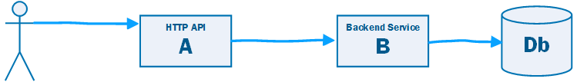

Slide 30
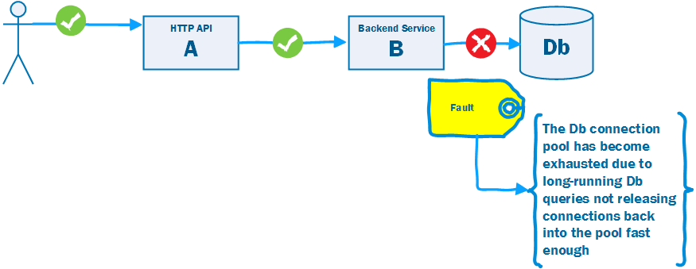

Slide 31
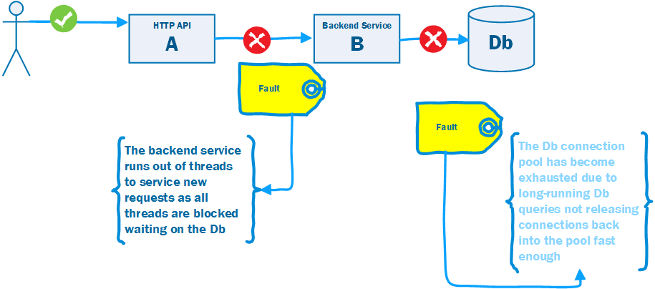

Slide 32
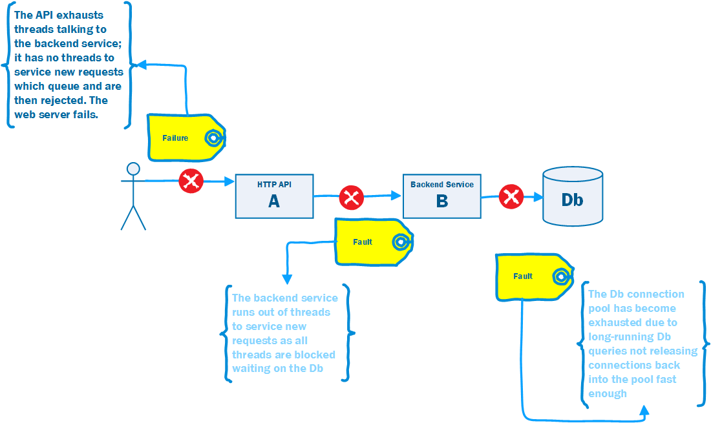

Slide 33
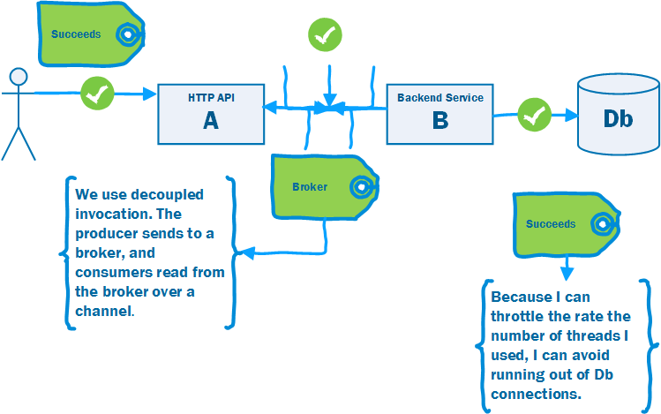

Slide 34
Decoupled Invocation Pattern
Use Decoupled Invocation. A producer puts a message onto a queue at the service endpoint. A consumer reads messages from the queue.
The queue stores messages for eventual processing. If the queue is durable we gain guaranteed delivery, and at-least once guarantees.
If the rate of arrival at the endpoint is unpredictable, the queue acts as a buffer that makes it possible to predict the rate of consumption.
This makes it simpler to do capacity planning because peaks of requests are smoothed out by the queue.
The consumer must be able to control the rate of processing, otherwise a spike is simply passed down the wire.
Notes:
As illustrated in figure 3.3, the Decoupled Invocation pattern is composed of three basic components: a handler, a queue, and a dispatcher that mediates between them. Here’s how the initial request processing works:
The handler listens for incoming requests from the endpoint.
When a new request arrives, the handler sends an acknowledgment to the sender.
The handler is responsible for the initial treatment, or preprocessing, of incoming messages. This may include message transformation or prioritization based on knowledge it infers from the messages themselves. Overall, this processing should be kept minimal, as the goal is to quickly queue and acknowledge incoming requests.
The message is put onto a queue.
The queue, which is the second component of the Decoupled Invocation pattern, stores incoming messages and allows the service to consume the messages at its own steady rate, thus overcoming peak loads.
You can set up the queue to be persistent so the service won’t lose any requests it has already acknowledged, even if a catastrophic server failure occurs. If the queue is transactional, you can also implement the Transactional Service pattern (see chapter 2) and increase the overall robustness of the service even further.
The dispatcher is responsible for creating as many reader components as are needed for the current request load, which is measured by the number of messages waiting in the queue. The dispatcher can also prioritize incoming tasks based on internal considerations, such as resource availability. The dispatcher is a good place to introduce elasticity if the latency of handling the messages is important. (See also the further reading section for an article on the LMAX architecture, which describes a low-latency, high-performance queue between senders and receivers.)
The handler can acknowledge the request as part of the preprocessing, but it’s usually best to do this inside an edge component (see the Edge Component pattern in chapter 2). This helps ensure that the service-processing load is kept to a minimum, allowing the handler to process requests as efficiently as possible.
Placing requests on the queue is a relatively low-cost operation that can be performed efficiently, making the initial request-handling less susceptible to failure during peaks (as compared to other parts of the request-handling that require more time and resources). The actual handling of the incoming requests can be performed at a reasonable pace, dictated by service resource availability and overall load. Load balancing can be achieved by running multiple readers against the queue.

Slide 35
Work Queue Pattern
A common distributed system (as opposed to integrated system) pattern.
A web site needs to respond < 250ms to scale. But some requests take longer…
Use decoupled invocation to put the work on a queue, offloading the long-running tasks, allowing the web server to respond in time.
202 Accepted and provide location to monitor for completion.

Slide 36
3.Request driven architectures
Integrating using RPC or REST

Slide 37
Request Driven Architecture
Direct
Bookings
Credit Card
Payments
Accounts
Housekeeping
Channel Manager
API
API
API
API
API
Db
Db
Db
Db
Db
Broker
Notes:
Temporal coupling is the problem that in order for us to make a Direct Booking the Channel Manager needs to be working. If we cannot update the channels, we do not take the customer’s booking. But of course this is problematic (1) Our uptime for our Direct Bookings Service is the product of the uptime of all the services that it calls (2) The channel manager may depend on external channels that have low uptimes and if so our direct bookings service becomes only as available as the worst availability of our channels (in fact worse as it is the product).
And would the business prefer: we can take a booking but might risk over-booking because one of our channels offers a room that we have already sold, or that we don’t take any bookings because we cannot guarantee against over-booking. For most business it is arguably the former
The server must be available when you call.
if I make a phone call, and you are not there I am shit out of luck. RPC is a phone call, direct communication between two participants and can be frustrating if you get a busy tone or no one answers. (nowadays we may leave an answer phone message, or send a text, but this is messaging not RPC). We will come to that later.
Pooling of resources can help here – one of anything can fail, so you need multiple servers
To avoid the client now having to know about where a server lives, which again defeats concept of RPC, then you have to use service-discovery in your runtime, so that location is hidden to caller. Good idea anyway, even if location transparency not our goal, not to have a fixed location.
Not true of decoupled invocation i.e. messaging of course.
“... the degree to which the sending and handling of a message are connected in time. If a sender is dependent on a receiver being available when a message is sent, we have high temporal coupling... Processes whose activities are strictly ordered or whose results carry forward, leaving subsequent activities unable to start until a response to a prior request has been received, are similarly temporally coupled. “ Ian Robinson

Slide 38
Request Driven Architecture
Direct
Bookings
Credit Card
Payments
Accounts
Housekeeping
Channel Manager
API
API
API
API
API
Db
Db
Db
Db
Db
Broker
Notes:
Temporal coupling is the problem that in order for us to make a Direct Booking the Channel Manager needs to be working. If we cannot update the channels, we do not take the customer’s booking. But of course this is problematic (1) Our uptime for our Direct Bookings Service is the product of the uptime of all the services that it calls (2) The channel manager may depend on external channels that have low uptimes and if so our direct bookings service becomes only as available as the worst availability of our channels (in fact worse as it is the product).
And would the business prefer: we can take a booking but might risk over-booking because one of our channels offers a room that we have already sold, or that we don’t take any bookings because we cannot guarantee against over-booking. For most business it is arguably the former
The server must be available when you call.
if I make a phone call, and you are not there I am shit out of luck. RPC is a phone call, direct communication between two participants and can be frustrating if you get a busy tone or no one answers. (nowadays we may leave an answer phone message, or send a text, but this is messaging not RPC). We will come to that later.
Pooling of resources can help here – one of anything can fail, so you need multiple servers
To avoid the client now having to know about where a server lives, which again defeats concept of RPC, then you have to use service-discovery in your runtime, so that location is hidden to caller. Good idea anyway, even if location transparency not our goal, not to have a fixed location.
Not true of decoupled invocation i.e. messaging of course.
“... the degree to which the sending and handling of a message are connected in time. If a sender is dependent on a receiver being available when a message is sent, we have high temporal coupling... Processes whose activities are strictly ordered or whose results carry forward, leaving subsequent activities unable to start until a response to a prior request has been received, are similarly temporally coupled. “ Ian Robinson

Slide 39
Daily: 2 minutes 53 seconds
Weekly: 20 minutes 10 seconds
Monthly:1 hour 26 minutes 24 seconds
Yearly: 17 hours 31 minutes 12 seconds
Availability
99.8%
99.95%
99.95%
99.95%
99.95%
Direct
Bookings
Credit Card
Payments
Accounts
Housekeeping
Channel Manager
API
API
API
API
API
Db
Db
Db
Db
Db
Broker
Notes:
An EC2 instance has an SLA of 99.5% as is AWS Lambda

Slide 40
Using A Proxy for Availability
We load balance the requests across multiple servers
Health Checks let us know who can we route to
Proxy
Proxy
Proxy
Proxy
Credit Card
Payments
Accounts
Housekeeping
Channel Manager
Direct
Bookings
Credit Card
Payments
Housekeeping
Channel Manager
Credit Card
Payments
Housekeeping
API
API
API
API
API
Channel Manager
The proxy can also support retry and or circuit breakers to help with availability
Db
Db
Db
Db
Db
Notes:
By using a proxy we can load balance our request across a group of servers – thus reducing our dependency on any one service being up and thus improving our availability\
If the service exports a health check then we can ensure that we only route to servers that are up, and thus able to fulfill our requests
We can also make retry and circuit breaker orthogonal concerns here, eliminating transient errors and preventing a thundering herd when it does happen

Slide 41
Config
Discovery
Monitoring
Policy
Control Plane
Data Plane
Proxy
Proxy
Proxy
Proxy
Proxy
Direct
Bookings
Credit Card
Payments
Accounts
Housekeeping
Channel Manager
Direct
Bookings
API
API
API
API
API
Credit Card
Payments
Housekeeping
Channel Manager
Direct
Bookings
Credit Card
Payments
Housekeeping
Channel Manager
Db
Db
Db
Db
Db
Notes:
If everything goes via a proxy, that proxy can be used as an interception point for centralizing services:
Configuration – we can dynamically provide configuration based on the runtime environment
Discovery – we can register new instances of services, allowing us to load balance across service instances
Monitoring – we can trace requests and provide visibility as to service health
Policy – authentication, TLS, rate limiting etc

Slide 42
Change Happens
?
Cleaning
API
Direct
Bookings
Credit Card
Payments
Accounts
Channel Manager
API
API
API
API
Db
Laundry
API
Db
Db
Db
Inventory
Db
Db
API
Broker
Db
Notes:
If we decide that we need to make changes to our capability map – for example we begin to break down the Housekeeping service – realizing that it was a group that supported a number of capabilities

Slide 43
Location Independence
Platform Coupling
Temporal Coupling
Connection-Oriented
Synchronous Communication
Data Format
Behavioral Coupling
Notes:
However RPC has its own issues because it does not resolve:
Location Independence: We would like clients to not have to know the location of a component which becomes particularly important if we want to redirect the client for performance or fault-tolerance
Platform Coupling: RPC tends to depend on both sender and receiver using the same platform, which may not always be possible, and means that we tie future change into what may be a 'legacy' technology
Temporal Coupling: RPC often requires us to make a series of calls to an interface to meet a requirement, and some calls must be made before others such as initializing the receiver. What is worse is that remote objects may depend on other objects and there is no mechanism for managing these dependencies, which means that developers must orchestrate these dependencies instead. This couples the client and receiver into a sequence of operations that must occur in sequence, which makes the software brittle to change.
Domain Coupling: One of our four tenets is to share schema not type - the problem with RPC is that it tends to share type, which bleeds the model of one domain into another. Now we can limit the damage here to some extent by using ideas like an anti-corruption layer to translate between models, but we are coupled to the types in the other system and will need to change if they change, if only to change out anti-corruption layer.
Synchronous Communication: RPC tends to depend on synchronous communication in which requests flow from clients and responses flow from the server. The problem here is that the client must create a session with the server to communicate, which does not easily allow fault-tolerance or publishing to multiple consumers at the same time. It also performs badly because the blocking call from the client ties up compute resources on the client whilst waiting on a response from the server.
Data Format: The client and server are bound by the ordering, type and number of parameters. If the server changes then the client will break. This forces us to to confirm client behavior by testing when we change the sender
Connection-Oriented: A connection-oriented protocol creates a session and then sends a stream of data between two applications in order. It is not fault tolerant as it assumes that the sender and receiver are both available at the same time. Defensive code becomes complicated bearing in mind that one of the components might not be available at the required time.
Trying to portray a remote communication as local-method invocation leads to trouble, because it elides from the developer the issues associated with a remote call.

Slide 44
4.Event driven architectures
Integrating using events

Slide 45

Event Driven Architecture
“Messaging over a lightweight message bus such as RabbitMQ”
Fowler and Lewis
Direct
Bookings
Credit Card
Payments
Accounts
Housekeeping
Channel Manager
API
API
API
API
API
Consumer has no notion of producer, just a topic on tbe broker
Channels subscribes to a ‘topic’ on the broker
Db
Db
Db
Db
Db
Broker
Notes:
A service publishes an event to a broker – usually using a topic or similar identifier
A consumer subscribes to that topic on the broker and receives messages
The channel usually offers guaranteed at least once delivery avoiding the issue of temporal coupling

Slide 46
Event Driven Architecture
Channel provides guaranteed at least once delivery
Direct
Bookings
Credit Card
Payments
Accounts
Housekeeping
Channel Manager
API
API
API
API
API
Db
Db
Db
Db
Db
Broker
Notes:
A service publishes an event to a broker – usually using a topic or similar identifier
A consumer subscribes to that topic on the broker and receives messages
The channel usually offers guaranteed at least once delivery avoiding the issue of temporal coupling

Slide 47
Bulkheads
Direct
Bookings
Credit Card
Payments
Accounts
Housekeeping
Channel Manager
API
API
API
API
API
Db
Db
Db
Db
Db
Broker
Notes:
Events provide a bulkhead to failure, containing the blast raduius

Slide 48
Event Driven Architecture
Direct
Bookings
Credit Card
Payments
The producer, Bookings, does not care that I split Housekeeping
Channel Manager
API
API
API
Cleaning
Laundry
API
API
Db
Db
Db
Db
Db
Broker

Slide 49
Platform independent data format
Sent to an addressable channel
Supports data transformations
Remote Communication
Platform/Language Independence
Asynchronous Communication
Throttling
Reliable Communication
Notes:
Standard data format that is platform independent: XML, JSON, YAML, CSV etc.
Send to an addressable channel and not to a specific machine (i.e. IP Address or domain name)
- A channel is a logical address which sender and receiver can agree on without knowing each other's true location
- As channel may be built on connection-oriented protocol, queue requests until the network and receiver are ready
- We need to support chunks of data or messages so that we know what to queue, instead of using a stream of data
Support data transformations so as to remove the dependency on a shared data format.
Remote Communication: Solves the problem of two applications communicating when they do not share a memory address space
Platform/Language Integration: Does not require the producer and consumer to use the same platform or language
Asynchronous Communication: Sender does not have to wait for receiver.
Throttling: We are able to queue requests for resources that are under contention so allowing us to throttle input to avoid overloading resources, instead allowing the receiver to consume that at a sustainable pace. At the same time we do not need to throttle the sender who can work at their preferred pace.
Reliable Communication: Message queues support retrying delivery of messages which means that once we send a message we know it will reach its destination. We can use guaranteed delivery to store these messages to persistent storage so that even if we lose the node trying to deliver the message we will be able to resume with no loss of messages.
More immediate than File Transfer; better encapsulated than shared database; more reliable than RPC
Does not require platform or language inter-operability between sender and receiver - an neutral broker
Asynchronous Communication [Fire-and-Forget]
Variable Timing [Sender does not wait for Producer]
Throttling [Receiver processes at own rate]
Reliable Communication [Store and Forward beats Temporal Coupling, Guaranteed Delivery]
Disconnected Operations [For example, work offline]
Mediator [Messaging provides service discovery, because only need to connect to the broker which routes messages to receivers; broker can be clustered to cope with failure]
Thread Management [The sender does not block waiting for the caller; the receiver does not block waiting for the sender

Slide 50
Messaging depends on Message-Oriented-Middleware (MOM)
Messaging depends on Message-Oriented-Middleware (MOM)
Routes messages between applications
Co-ordinates sending and receiving of messages
Sender and receiver have the same availability
Asynchronous: Send and Forget
Store and Forward
Notes:
Messaging depends on Message-Oriented-Middleware (MOM)
Routes messages between applications
Co-ordinates sending and receiving of messages
A messaging system overcomes issue with reliability - temporal coupling - as the sender and receiver have the same availability
Create
Send
Deliver
Receive
Process
Send and Forget
A sender does not block once the message reaches the MOM
Store and Forward
When the sending application sends, the MOM stores the message
Delivery can be retried until it succeeds
This is ‘guaranteed delivery’ and it overcomes temporal coupling

Slide 51
Complex Programming Model
Sequencing
Eventual Consistency
Many Moving Parts
Performance
Lock-In
Notes:
Disadvantages of Messaging
Complex programming model: Application logic in an event-driven system is divided across a number of event handlers that respond to incoming messages. This can make it harder to reason about the system and its effects. Debugging becomes harder because we may have to open up multiple IDEs, or read a variety of different logs. We may also have more complex concerns around how to monitor systems, heavier configuration requirements, and generally an increased burden to support our system in a live environment.
Sequencing: Message channels do not usually guarantee order and timing, so messages may be received out of sequence, and care is needed to handle this issue.
Consistency: Essentially messaging systems have high availability and partition tolerance, but lose consistency. This is due to the latency in sending, receiving and processing a message between two systems which means they may provide inconsistent views of state at any one time.
Availability: Messaging systems have more moving parts as well as the MOM itself. This is a more complex availability problem because unlike a monolithic system where we only have to introduce redundancy and load balancing for one component we now have to introduce redundancy and load balancing for many components.
Complex Programming Model [Asynchronous and Event-Driven]
Sequencing [May be hard to control timing of processing of messages]
Synchronous Requirements [Some applications require synchronous responses]
Performance [Time to package, send, unpackaged; throttling slows rate causing eventual consistency or even partition]
For bulk data transfer - ETL followed by updates over messaging faster than just messaging
Limited Platform Support [Not all MOM available everywhere (MQMQ on Linux?)]
Vendor Lock-In [A vendor product lies at the heart of the application]

Slide 52
RPC: How to Make a Good Cup of Tea
“Now this is serious! if there’s one thing in this country that really bothers me/ Its’ the inability of yanks to make a good cup of tea”
T.U.S.A. Masters of Reality.

Slide 53
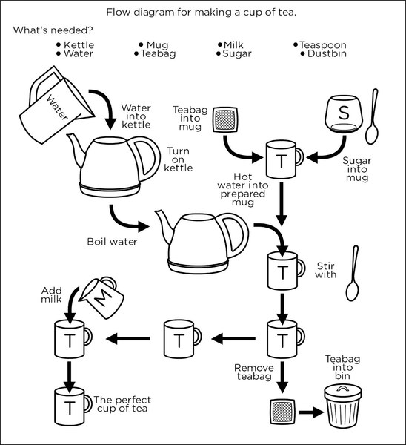

Slide 54
Demo
Notes:
~PythonProjects/github/iancooper/RpcIsEvil/
Make sure that you run virtualenvwrapper to load the python environment first!

Slide 55
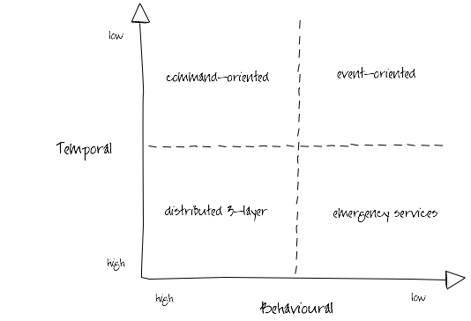
Ian Robinson: http://iansrobinson.com/2009/04/27/temporal-and-behavioural-coupling/
Notes:
Distributed 3-layer
Traditional 3-layer application architecture blown up to distributed proportions. Characterized by call stack-like, imperative behaviour (high temporal and behavioural coupling) and synchronous request-response interactions. Includes systems that layer synchronous interactions on top of asynchronous message exchanges. Senders tell receivers what to do; receivers execute the sender’s orders. Sender and all intermediaries block until the call stack unwinds, effectively locking and/or consuming system resources further up the call chain. This blocking behaviour undermines the autonomy of upstream components and at the same time increases the availability requirements of downstream components. As Michael Nygard’s Release It! reminds us, in these circumstances the availability of the overall system can be no more than that of the least available participant, and the probability of failure is the joint probability of failure in any component or service.
Command-oriented
“Good”, “orthodox” SOA. Low degree of temporal coupling characterized by asynchronous interactions, deferred state and a resumable programming model (process or activity instances are dehydrated between remote invocations in order to conserve resources, and then rehydrated based on correlated responses). Senders typically determine what needs to be done, but rely on receivers to determine how to execute their instructions. This behavioral coupling can require providers to evolve (message formats, supported operations) in lockstep with changing consumer demands.
Event-oriented
Low temporal and behavioral coupling. Receivers determine both what needs to be done and how to do it based on the content of received messages. Resumable programming model: processes are suspended or dehydrated, waiting for events. Can be difficult to trace the execution path of an end-to-end transaction or activity. Exposing an ExtinguishFire operation is a command-oriented way of executing a business process; acting on FireStarted notifications an event-oriented approach.
Emergency services
So called because you tell them what happened, and they decide what to do, but if there’s no one to take your call, you’re hosed. Low behavioural coupling, which allows for the independent evolution of system components, but a degree of temporal coupling, impacting availability requirements of participants. Many RESTful solutions occupy this quadrant. URI-templated solutions have a higher degree of behavioural coupling than hypermedia-driven solutions (where servers constrain and guide what a client can do next, and determine how best to satisfy requests); client polling and caching can mitigate some of these temporal coupling issues.

Slide 56
5.Messaging patterns
Integrating using events

Slide 57
5.1 types of messages

Slide 58
Message Construction
A message has a header and body
Message Intent: Command, Document, Event
Request-Reply: needs Return Channel and Correlation Identifier
Break a large message into pieces as a Message Sequence
Slow messages: One way to deal with eventual consistency is to create a Message Expiry
Notes:
Messages 5m
- Two processes communicating need to copy the data between processes - usually as a stream of bytes. We need to break up this stream into discrete units so that we can tell when a message on the channel begins and ends. Otherwise we could not use competing consumers to read messages from the stream or publish to multiple subscribers
- A message has a header, how to process and a body, the content
- Three types: Command (invoke), Document (share data), Event (notify of change)
- The difference between event and document are that with document the emphasis on the content of the message, with an event the emphasis is on the occurrence itself.
Message Intent: Command, Document, Event
Request-Reply: (Usually Command-Document), tends to use Return Address and Correlation Identifier
In essence RPC over messaging
Break a large message into pieces with Message Sequence
Slow messages: One way to deal with eventual consistency is to create a Message Expiry, and if a message is not delivered within a time-window delete or add to Dead Letter Queue
Message: An atomic packet of data transmitted on a channel
Messaging transmits discrete units of data by marshalling the data from the sender and unmarshalling it in the receiver so that the receiver has its own local copy.
Data to be sent must be converted into one of more messages that can be sent
A message has two basic parts: header (metadata used by the messaging system); body (the payload used by the receiver).
Command Message: Invoke a procedure in another application
Document Message: Pass data to another application
Event Message: Notify another application about a change
Request-Reply: The sender expects a reply
Message Sequence: Split a message into parts; receive before Message Expiration
Canonical Data Format: The body format to be understood by producer and consumer

Slide 59
Command Message
Use a Command Message to reliably invoke a procedure in another application
Uses the well-established pattern for encapsulating a request as an object. The Command pattern [GoF] turns a request into an object that can be stored and passed around.
Notes:
Command Message: Use a Command Message to reliably invoke a procedure in another application. The advantage o f Remote Procedure Invocation is that it’s synchronous, so the call is performed immediately while the caller’s thread blocks. But that’s also a disadvantage. If the call cannot be executed immediately— either because the network is down or because the remote process isn’t running and listening— then the call doesn’t work. If the call were asynchronous, it could keep trying until the procedure in the remote application is successfully invoked. There’s a well-established pattern for encapsulating a request as an object. The Command pattern [GoF] shows how to turn a request into an object that can be stored and passed around. If this object were a message, then it could be stored in and passed around through a Message Channel (60). Likewise, the command’s state (such as method parameters) can be stored in the message’s state. Usually sent over a Point-to-Point channel as there is only one consumer.

Slide 60
Document Message
Use a Document Message to reliably transfer a data structure between applications.
The receiver decides what, if anything, to do with the data
Notes:
Document Message: Use a Document Message to reliably transfer a data structure between applications. Whereas a Command Message tells the receiver to invoke certain behavior, a Document Message just passes data and lets the receiver decide what, if anything, to do with the data. The data is a single unit of data, a single object or data structure that may decompose into smaller units. Guaranteed Messaging may be appropriate, but not Message Expiration.

Slide 61
Event Message
Use an Event Message for reliable, asynchronous event notification between applications.
The difference between an Event Message and a Document Message is a matter of timing and content. An event’s contents are typically less important.
Notes:
Event Message: Several applications would like to use event notification to coordinate their actions and would like to use Messaging (53) to communicate those events. Use an Event Message for reliable, asynchronous event notification between applications. The difference between an Event Message and a Document Message (147) is a matter of timing and content. An event’s contents are typically less important. Many events even have an empty message body; their mere occurrence tells the observer to react. An event’s timing is very important; the subject should issue an event as soon as a change occurs, and the observer should process it quickly while it’s still relevant.

Slide 62


A Command
An Event
Notes:
We may prefer and event to a command when integrating.
A Command says: Do this thing i.e. Make me a cup of tea. This works if the client is there, I will get a cup of tea, but if the client is not I must have used some middleware in the runtime to guarantee at least once delivery. You might also refuse me, perhaps you are busy.
An Event says: Here is the state I am in. Can you help? We are open here to anyone handling it. I don’t care who gets me tea, I just want tea. Some potential tea bringers may be busy, but another one might bring me tea.

Slide 63
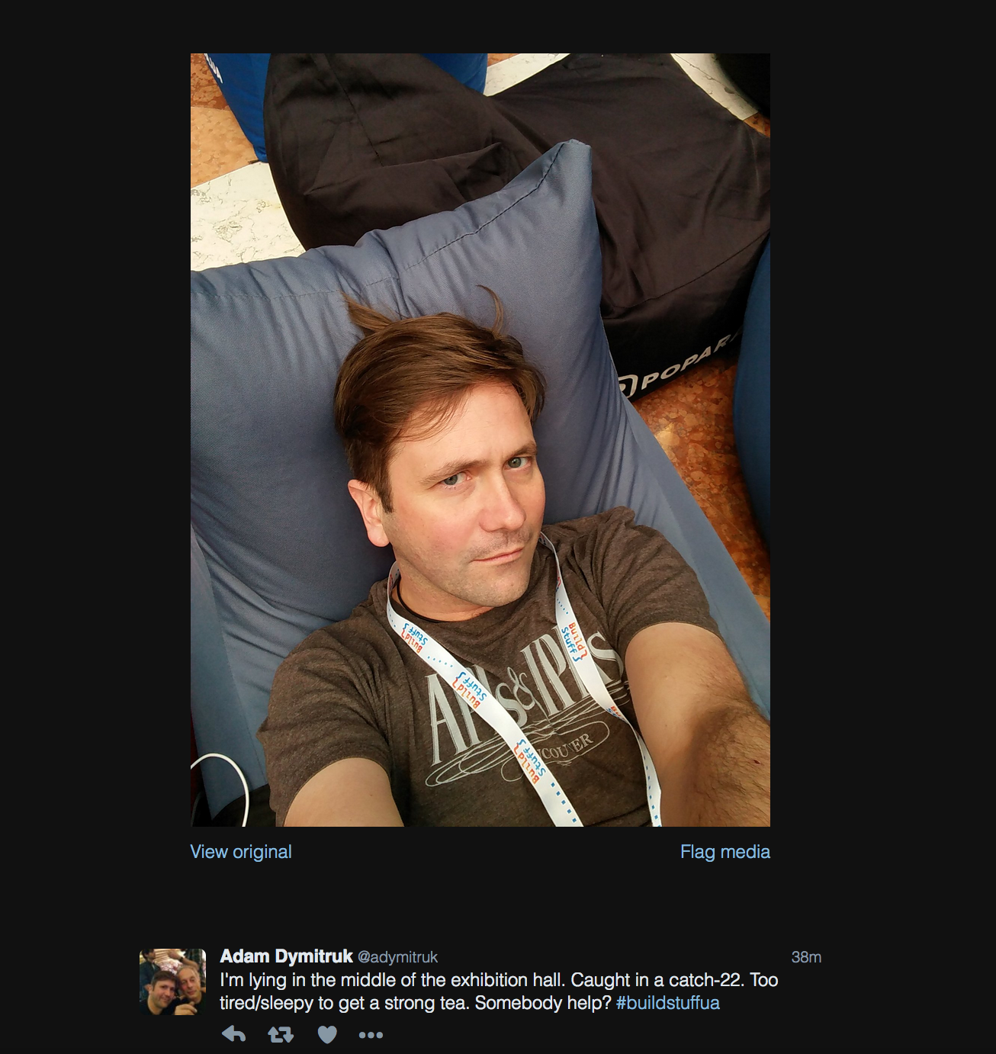

Slide 64
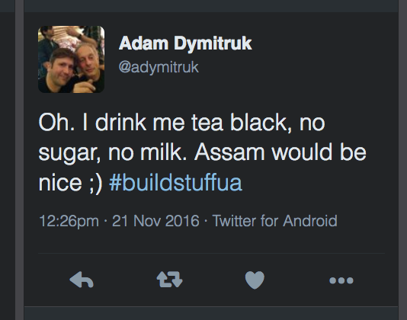

Slide 65
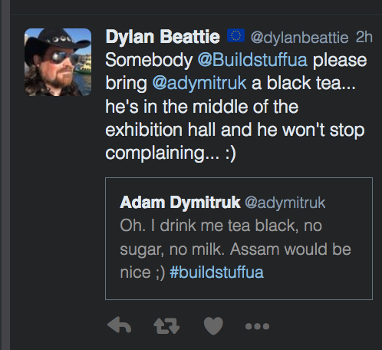

Slide 66
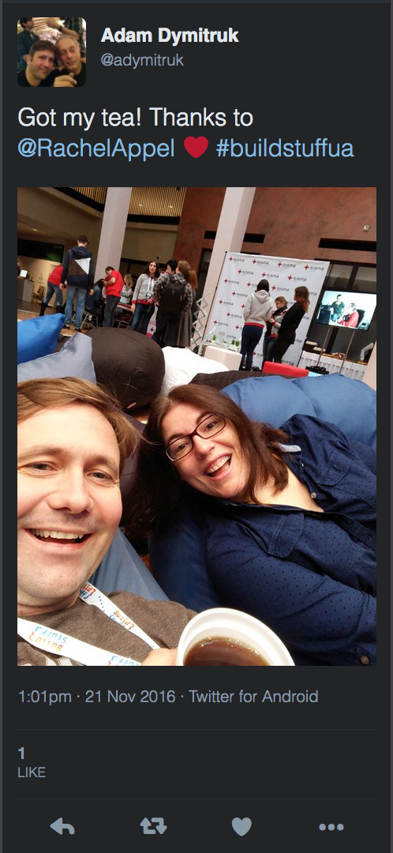

Slide 67
Request-Reply
When an application sends a message, how can it get a response from the receiver?
Send a pair of Request-Reply messages, each on its own channel.
Synchronous Block: Sender blocks whilst polling for reply.
Asynchronous Callback: A separate thread listens for reply messages.
Notes:
Request-Reply: When an application sends a message, how can it get a response from the receiver? Send a pair of Request-Reply messages, each on its own channel.
Synchronous Block: Sender blocks whilst polling for reply. Simple to implement, lower reliability, ties up thread waiting for response
Asynchronous Callback: A separate thread listens for reply messages. Harder to implement for timing issues, more reliable, removes temporal coupling and resource wastage

Slide 68
The request message should contain a Return Address that indicates where to send the reply message
Each reply message should contain a Correlation Identifier, a unique identifier that indicates which request message this reply is for.
Notes:
Message needs Reply Address, must have Correlation Identifier to sender and receiver
Return Address: The request message should contain a Return Address that indicates where to send the reply message. Makes it easier to change than hard-coding response channel into receiver
Correlation Identifier: Each reply message should contain a Correlation Identifier, a unique identifier that indicates which request message this reply is for. This is how a Correlation Identifier works: When the requestor creates a request message, it assigns the request a request ID— an identifier that is different from those for all other currently outstanding requests, that is, requests that do not yet have replies. When the replier processes the request, it saves the request ID and adds that ID to the reply as a correlation ID. When the requestor processes the reply, it uses the correlation ID to know which request the reply is for. This is called a Correlation Identifier because of the way the caller uses the identifier to correlate (i.e., match; show the relationship) each reply to the request that caused it.

Slide 69
Message Sequence
Whenever a large set of data needs to be broken into message-size chunks, send the data as a Message Sequence
Sequence identifier— Distinguishes this cluster of messages from others.
Size or End indicator— Specifies the number of messages
Position identifier— Uniquely identifies and sequentially orders each message in a sequence.
Notes:
Message Sequence: Whenever a large set of data needs to be broken into message-size chunks, send the data as a Message Sequence and mark each
The three Message Sequence identification fields are as follows.
Sequence identifier— Distinguishes this cluster of messages from others.
Position identifier— Uniquely identifies and sequentially orders each message in a sequence.
Size or End indicator— Specifies the number of messages in the cluster or marks the last message in the cluster (whose position identifier then specifies

Slide 70
Useful Properties
Message Expiration: specify a time limit for how long the message is viable.
Format Indicator: An indicator of schema and/or version
Notes:
Message Expiration: Message Expiration to specify a time limit for how long the message is viable.
Format Indicator: How can a message’s data format be designed to allow for possible future changes? Design a data format that includes a Format Indicator so that the message specifies what format it is using.
Version Number— A number or string that uniquely identifies the format. Both the sender and receiver must agree on which format is designated by a particular indicator. The advantage of this approach is that the sender and receiver do not have to agree on a shared repository for format descriptors, but the drawback is that each must know what descriptor is indicated and where to access it.
Foreign Key— A unique ID— such as a filename, a database row key, a home primary key, or an Internet URL— that specifies a format document. The sender and receiver must agree on the mapping of keys to documents and the format of the schema document. The advantage of this approach is that the foreign key is very compact and can point to a detailed data format description in a shared repository. The main drawback lies in the fact that each messaging participant has to retrieve the format document from a potentially remote resource.
Format Document— A schema that describes the data format. The schema document does not have to be retrieved via a foreign key or inferred from a version number; it is embedded in the message. The sender and the receiver must agree on the format of the schema. The advantage of this alternative is that messages are self-contained. However, message traffic increases because each message carries format information that rarely changes.

Slide 71
2.2 channels

Slide 72
Channels
A virtual pipe that connects producer and consumer
Messaging is not a ‘bucket’. A consumer can filter according to the type of information it wants
Logical Address
Unidirectional
One-to-One or One-to-Many
Notes:
What is a channel?
Logical Address: Channels are logical addresses in a messaging system. The details of implementation are hidden from applications using the channel, they just need to know how to address the channel.
Channel: A virtual pipe that connects sender to receiver.
A messaging system is not implemented as a bucket. A receiver knows what type of information it wants, and the sender can identify what it is
A sender sends to a particular channel and a receiver reads from a particular channel
Channels are logical addresses in the MOM
Implementation details such as messages are stored on sender and receiver or in a distributed database are hidden from the user
The application or administrator has to create them, they are not pre-configured
Point-to-point channels and publish-subscribe channels
Datatype channels avoid the confusion of mixing data types over one channel; Selective Consumer allows multiplexing channels
Invalid Message Channel — a channel for messages that could not be consumed
Unidirectional—we don’t want to consumer our own messages; use Request-Reply for bi-directional flow (sender indicates return channel)
Often fixed set, especially for more complex topologies
One-to-one (Point-to-point Channel) or One to Many (Publish-Subscribe Channel)
Type: Use a DataType Channel - everything on the channel is the same type. Favour many channels over the receiver interpreting the type and deciding how to route it internally.
Invalid messages: the receiver cannot ‘read’ the message successfully to process it, goes on invalid message channel; if MOM cannot deliver to a consumer, sends to dead-letter channel
By default messages are stored in memory, Guaranteed Delivery means that the message is stored to disk and will survive a crash; availability vs. performance trade-off

Slide 73
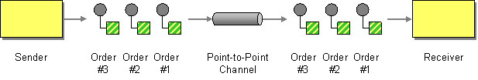
Point-to-Point Channel
http://www.enterpriseintegrationpatterns.com/patterns/messaging/PointToPointChannel.html
Notes:
How can the caller be sure that exactly one receiver will receive the document or perform the call?
Send the message on a Point-to-Point Channel, which ensures that only one receiver will receive a particular message.
A Point-to-Point Channel ensures that only one receiver consumes any given message. If the channel has multiple receivers, only one of them can successfully consume a particular message. If multiple receivers try to consume a single message, the channel ensures that only one of them succeeds, so the receivers do not have to coordinate with each other. The channel can still have multiple receivers to consume multiple messages concurrently, but only a single receiver consumes any one message.
Send a Command on a Point-to-Point channel to ensure only one receiver will receive a particular message; if there are Competing Consumers only one will read any message

Slide 74
2.1.1 RMQ Abstractions

Slide 75
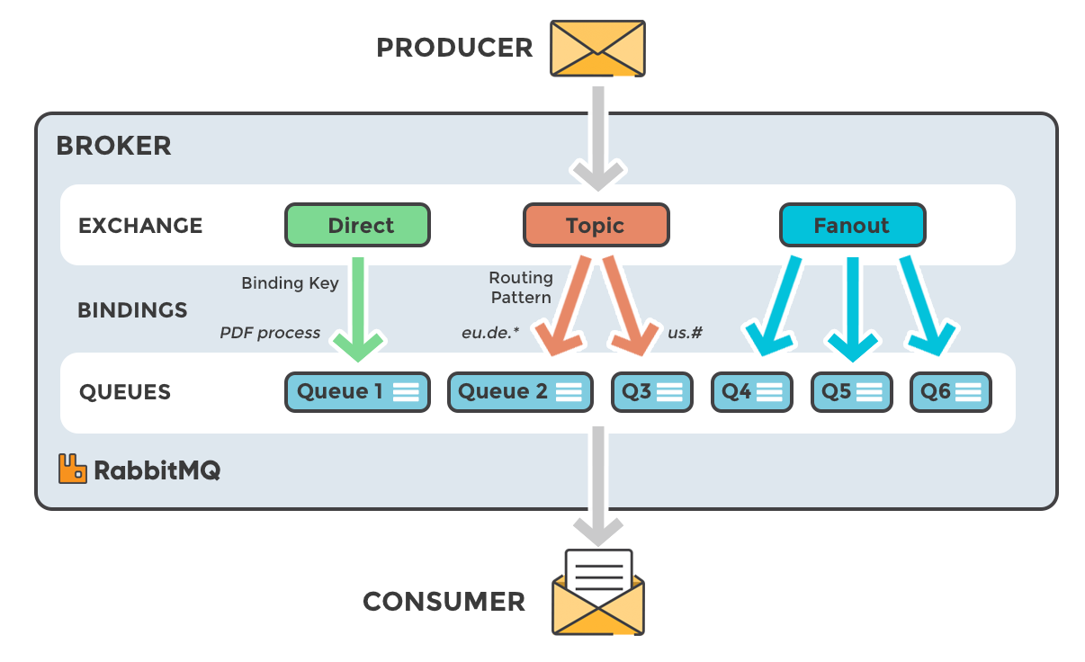
RMQ COMPONENTS
https://www.cloudamqp.com/blog/2015-05-18-part1-rabbitmq-for-beginners-what-is-rabbitmq.html

Slide 76
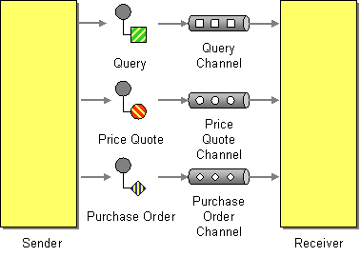
Datatype Channel
http://www.enterpriseintegrationpatterns.com/patterns/messaging/DatatypeChannel.html
Notes:
An application is using Messaging to transfer different types of data, such as different types of documents.
How can the application send a data item such that the receiver will know how to process it?
Use a separate Datatype Channel for each data type, so that all data on a particular channel is of the same type.
By using a separate Datatype Channel for each type of data, all of the messages on a given channel will contain the same type of data. The sender, knowing what type the data is, will need to select the appropriate channel to send it on. The receiver, knowing what channel the data was received on, will know what its type is.
The receiver must know what type of messages it is receiving or it won’t know how to process them. Use a separate Datatype Channel for each datatype so that all the data on a particular channel is of the same type.

Slide 77
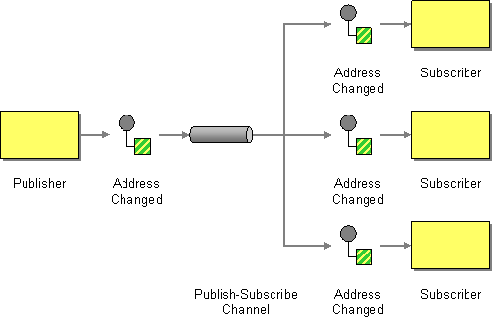
Publish-Subscribe Channel
http://www.enterpriseintegrationpatterns.com/patterns/messaging/PublishSubscribeChannel.html
Notes:
An application is using Messaging to announce events.
How can the sender broadcast an event to all interested receivers?
Send the event on a Publish-Subscribe Channel, which delivers a copy of a particular event to each receiver.
A Publish-Subscribe Channel works like this: It has one input channel that splits into multiple output channels, one for each subscriber. When an event is published into the channel, the Publish-Subscribe Channel delivers a copy of the message to each of the output channels. Each output channel has only one subscriber, which is only allowed to consume a message once. In this way, each subscriber only gets the message once and consumed copies disappear from their channels.
Send an event on a Publish-Subscribe Channel which delivers a copy to all receivers; also allows eavesdropping on a message; a firehose of all channels can act like a message store

Slide 78
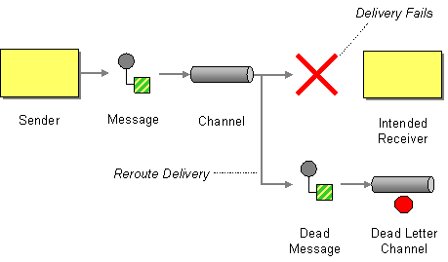
Dead Letter Channel
http://www.enterpriseintegrationpatterns.com/patterns/messaging/DeadLetterChannel.html
Notes:
An enterprise is using Messaging to integrate applications.
What will the messaging system do with a message it cannot deliver?
When a messaging system determines that it cannot or should not deliver a message, it may elect to move the message to a Dead Letter Channel.
The specific way a Dead Letter Channel works depends on the specific messaging system’s implementation, if it provides one at all. The channel may be called a “dead message queue” [Monson-Haefel, p.125] or “dead letter queue.” [MQSeries], [Dickman, pp.28-29] Typically, each machine the messaging system is installed on has its own local Dead Letter Channel so that whatever machine a message dies on, it can be moved from one local queue to another without any networking uncertainties. This also records what machine the message died on. When the messaging system moves the message, it may also record the original channel the message was supposed to be delivered on.
When a messaging system determine that it cannot or should not deliver a message, it may elect to move the message to a dead-letter channel.

Slide 79
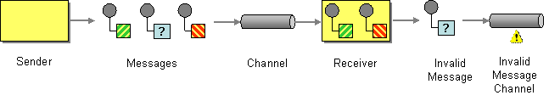
Invalid Message Channel
http://www.enterpriseintegrationpatterns.com/patterns/messaging/InvalidMessageChannel.html
Notes:
An application is using Messaging to receive Messages.
How can a messaging receiver gracefully handle receiving a message that makes no sense?
The receiver should move the improper message to an Invalid Message Channel, a special channel for messages that could not be processed by their receivers.
When designing a messaging system for applications to use, the administrator will need to define one or more Invalid Message Channels for the applications to use.
Where the message cannot be interpreted by the receiver even if well-formed i.e. is missing headers, or the body has an unexpected content type or does not match the expected schema. Although the MOM has delivered the message to the receiver it cannot be passed to application code to process. In this case the message is sent to an Invalid Message Channel a special channel for messages that could not be processes by their receivers. Messages that cause application errors, but are well formed, should not be placed on the Invalid Message Channel—treat them as application errors. If using a Service Activator or Messaging Gateway then errors in the message handling framework should be passed on to the Invalid Message Channel, but errors in the application code should not. It usually indicates an integration problem either in code or configuration.

Slide 80
2.3 endpoints

Slide 81
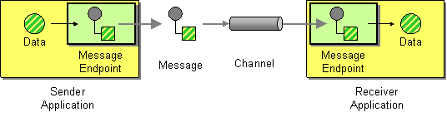
Message Endpoint
http://www.enterpriseintegrationpatterns.com/patterns/messaging/MessageEndpoint.html
Notes:
Applications are communicating by sending Messages to each other via Message Channels.
How does an application connect to a messaging channel to send and receive messages?
Connect an application to a messaging channel using a Message Endpoint, a client of the messaging system that the application can then use to send or receive messages.
Message Endpoint code is custom to both the application and the messaging system’s client API. The rest of the application knows little about message formats, messaging channels, or any of the other details of communicating with other applications via messaging. It just knows that it has a request or piece of data to send to another application, or is expecting those from another application. It is the messaging endpoint code that takes that command or data, makes it into a message, and sends it on a particular messaging channel. It is the endpoint that receives a message, extracts the contents, and gives them to the application in a meaningful way.

Slide 82
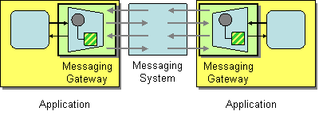
Messaging Gateway
http://www.enterpriseintegrationpatterns.com/patterns/messaging/MessagingGateway.html
Notes:
An application accesses another system via Messaging.
How do you encapsulate access to the messaging system from the rest of the application?
Use a Messaging Gateway, a class than wraps messaging-specific method calls and exposes domain-specific methods to the application.
The Messaging Gateway encapsulates messaging-specific code (e.g., the code required to send or receive a message) and separates it from the rest of the application code. This way, only the Messaging Gateway code knows about the messaging system; the rest of the application code does not. The Messaging Gateway exposes a business function to the rest of the application so that instead of requiring the application to set properties like Message.MessageReadPropertyFilter.AppSpecific, a Messaging Gateway exposes methods such as GetCreditScore that accept strongly typed parameters just like any other method. A Messaging Gateway is a messaging-specific version of the more general Gateway pattern [EAA].

Slide 83
2.3.1 The Message PuMP

Slide 84
Message Pump – Event Loop
While True
request = TranslateMessage()
msg = GetMessage()
Ack(msg)
DispatchMessage(request)
Sleep()
End While
Notes:
At the most basic level, the message pump gets a message from the queue, in a loop. It sleeps in between loops to avoid spinning a core.
But what does it do with the message.
We need to translate the message from the wire format to something we understand. So we use a translate message step, which says, read the body of the message on the wire and use it to serialize a type that we understand
We then want to act upon that request, so we need to find some code to handle it

Slide 85
Message Pump – Stopping
While True
If msg.Type == MT_QUIT
Break
End If
msg = GetMessage()
…
Sleep()
If Token.IsSignalled
Break
End If
End While
Notes:
How do we stop the pump.
One option is to have a synchronization token that gets signaled and we just check that token to see if it has been signaled at the end of the loop

Slide 86
Message Pump – Buffer
Post Quit Message To Buffer
While True
Fill Buffer From Queue if Empty
msg = GetMessage()
If msg.Type == MT_QUIT
Break
End If
request = TranslateMessage()
DispatchMessage(request)
Ack(msg)
Sleep()
End While

Slide 87
The Buffer – Latency vs. Availability
But reading too much has risks.
* We may not distribute work evenly across consumers.
* If we crash message locks have to ‘time out’
We read from a buffer, which allows us to control the pump by issuing a quit message
Any call to fill the buffer from the queue incurs latency.
It is more efficient to amortize that cost by bringing back more messages
If the buffer is empty we read from the queue to fill the buffer

Slide 88

Message Pump – Message Mapper
RegisterMessageMapper(typeof(myMessage, typeof(MyMapper))
request = TranslateMessage(msg)
Get MessageMapper(typeof(msg)
Often this is a default to a serialize class to or from JSON etc.
But it is an important interception point to control versioning
Def Class MessageMapper
Def MapFromMessage(Message)
….
return request
End Def
End Def

Slide 89
Message Pump – Dispatcher & Handler
RegisterMessageHandler(typeof(myMessage, typeof(MyHandler))
DispatchMessage(request)
Get MessageHandler(typeof(msg)
The handler is the code developers have to write, the rest is usually framework code.
Def Class MessageHandler
Def Handle(Request)
….
End Def
End Def
89

Slide 90
Message Mapper Registry
Handler Registry
Lookup Mapper
Lookup Handler
Get Message
Translate Message
Dispatch Message
Handle Message
Notes:
A Messaging Mapper converts domain objects into a message as required by the messaging channel.
It also provides the reverse capability, create or update a domain objects based on an incoming messages.
Because of this mediator, the domain does not need to know about messaging formats and vice-versa
When integrating applications using messaging, the data inside a message is often derived from domain objects inside the integrated applications. If we use a Document Message, the message itself may directly represent one or domain objects. If we use a Command Message, some of the data fields associated with the command are likely to be extracted from domain objects as well. There are some distinct differences between messages and objects. For example, most objects rely on associations in the form of object references and inheritance relationships. Many messaging infrastructures do not support these concepts because they have to be able to communicate with a range of applications, some of which may not be object-oriented at all.
How do you move data between domain objects and the messaging infrastructure while keeping the two independent of each other?
Create a separate Messaging Mapper that contains the mapping logic between the messaging infrastructure and the domain objects. Neither the objects nor the infrastructure have knowledge of the Messaging Mapper's existence.
The Messaging Mapper accesses one or more domain objects and converts them into a message as required by the messaging channel. It also performs the opposite function, creating or updating domain objects based on incoming messages. Since the Messaging Mapper is implemented as a separate class that references the domain object(s) and the messaging layer, neither layer is aware of the other. The layers don't even know about the Messaging Mapper.

Slide 91
Dead Letter Queue
Error Log
Error Log
Invalid Message Queue
Failure to understand
Unexpected
Unrecoverable
Exception
Failure to deliver
Get Message
Translate Message
Dispatch Message
Handle Message
Requeue to Limit
Recoverable
Exception

Slide 92
Message Pump – Supervisor & Worker
A buffer might be shared by many threads which is efficient in high-latency i.e. cloud but requires a semaphore on the buffer for ‘filling’
A buffer might be per worker, simplest as no concurrency
Supervisor Thread
A worker thread can be single-threaded which allows ordering.
Worker Threads

Slide 93
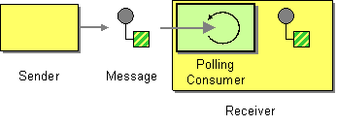
Polling Consumer
http://www.enterpriseintegrationpatterns.com/patterns/messaging/PollingConsumer.html
Notes:
An application needs to consume Messages, but it wants to control when it consumes each message.
How can an application consume a message when the application is ready?
The aplication should use a Polling Consumer, one that explicitly makes a call when it wants to receive a message.
This is also known as a synchronous receiver, because the receiver thread blocks until a message is received. We call it a Polling Consumer because the receiver polls for a message, processes it, then polls for another. As a convenience, messaging API’s usually provide a receive method that blocks until a message is delivered, in addition to methods like receiveNoWait() and Receive(0) that return immediately if no message is available. This difference is only apparent when the receiver is polling faster than messages are arriving.

Slide 94

Event Driven Consumer
http://www.enterpriseintegrationpatterns.com/patterns/messaging/EventDrivenConsumer.html
Notes:
An application needs to consume Messages as soon as they’re delivered.
How can an application automatically consume messages as they become available?
The application should use an Event-Driven Consumer, one that is automatically handed messages as they’re delivered on the channel.
This is also known as an asynchronous receiver, because the receiver does not have a running thread until a callback thread delivers a message. We call it an Event-Driven Consumer because the receiver acts like the message delivery is an event that triggers the receiver into action.

Slide 95
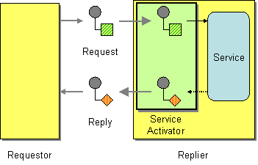
Service Activator
http://www.enterpriseintegrationpatterns.com/patterns/messaging/MessagingAdapter.html
Notes:
An application has a service that it would like to make available to other applications.
How can an application design a service to be invoked both via various messaging technologies and via non-messaging techniques?
Design a Service Activator that connects the messages on the channel to the service being accessed.
A Service Activator can be one-way (request only) or two-way (Request-Reply). The service can be as simple as a method call—synchronous and non-remote—perhaps part of a Service Layer [EAA]. The activator can be hard-coded to always invoke the same service, or can use reflection to invoke the service indicated by the message. The activator handles all of the messaging details and invokes the service like any other client, such that the service doesn’t even know it’s being invoked through messaging.

Slide 96
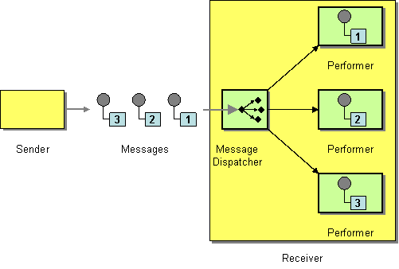
Competing Consumers
http://www.enterpriseintegrationpatterns.com/patterns/messaging/MessageDispatcher.html
Notes:
Increase the number of consumers reading messages from the queue. The message queue must hand a message to only one consumer. It must allow waiting consumers to read messages further down the queue if the message at the top is locked.
Highly Scalable, particularly with elastic compute – just add consumer nodes.

Slide 97
2.4 Pipelines

Slide 98

Pipes and Filters
http://www.enterpriseintegrationpatterns.com/patterns/messaging/PipesAndFilters.html
Notes:
Pipes and Filters 5m
May need to do 'work' when transmitting a message - we might need to encrypt/decrypt a message, we might need to enrich the content of the message from collaborators before delivery, we might need to transform the message between source and destination if we do not control and cannot manage both, we might need to route messages.
Pipes and filters is a Unix pattern for dividing work into small, daily testable pieces that can be combined together. We can treat a channel as the pipe, and processes that read from and forward to as filters, to adjust a message. Often we want to abstract the channel, so we can choose between MOM or an in-memory queue for runtime efficiency.
The structure of pipes and filters is straightforward. Each filter receives a message on an inbound channel and publishes it on an outbound channel. Because each filter uses the same approach they can be composed into a chain. This allows simple, easily testable filters to be composed into arbitrarily complex applications. Composition allows us to re-use filters in new contexts, without changing them (in OO this is the Open-Closed principle).
In the original Pipes and Filters pattern the interface of a filter has one input and one outputs. Messaging relaxes this somewhat to allow
A processing pipeline lets us work in parallel, because a filter can take more work off the queue to process when done, instead of blocking whilst the rest of the pipeline completes. This is known as a processing pipeline because messages flow through the filters like liquid through a pipe. A processing pipeline helps to increase throughput.
A processing pipeline's throughput is limited by the slowest point in the chain. We could use multi-threading within that filter, but the alternative is to use competing consumers to parallelize the work of a stage. This allows one of many consumers to complete the work of that stage and is simpler to program and debug than using multi-threading.
In many enterprise integration scenarios, a single event triggers a sequence of processing steps, each performing a specific function. For example, let's assume a new order arrives in our enterprise in the form of a message. One requirement may be that the message is encrypted to prevent eavesdroppers from spying on a customer's order. A second requirement is that the messages contain authentication information in the form of a digital certificate to ensure that orders are placed only by trusted customers. In addition, duplicate messages could be sent from external parties (remember all the warnings on the popular shopping sites to click the 'Order Now' button only once?). To avoid duplicate shipments and unhappy customers, we need to eliminate duplicate messages before subsequent order processing steps are initiated. To meet these requirements, we need to transform a stream of possibly duplicated, encrypted messages containing extra authentication data into a stream of unique, simple plain-text order messages without the extraneous data fields.
How can we perform complex processing on a message while maintaining independence and flexibility?
Use the Pipes and Filters architectural style to divide a larger processing task into a sequence of smaller, independent processing steps (Filters) that are connected by channels (Pipes).
Each filter exposes a very simple interface: it receives messages on the inbound pipe, processes the message, and publishes the results to the outbound pipe. The pipe connects one filter to the next, sending output messages from one filter to the next. Because all component use the same external interface they can be composed into different solutions by connecting the components to different pipes. We can add new filters, omit existing ones or rearrange them into a new sequence -- all without having to change the filters themselves. The connection between filter and pipe is sometimes called port. In the basic form, each filter component has one input port and one output port.

Slide 99
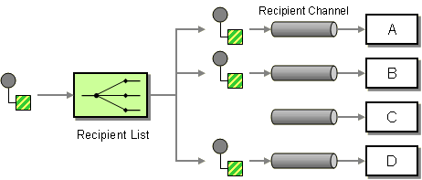
Recipient List
http://www.enterpriseintegrationpatterns.com/patterns/messaging/RecipientList.html
Notes:
A Content-Based Router allows us to route a message to the correct system based on message content. This process is transparent to the original sender in the sense that the originator simply sends the message to a channel, where the router picks it up and takes care of everything.
In some cases, though, we may want to specify one or more recipients for the message. A common analogy are the recipient lists implemented in most e-mail systems. For each e-mail message, the sender can specify a list of recipients. The mail system then ensures transport of the message content to each recipient. An example from the domain of enterprise integration would be a situation where a function can be performed by one or more providers. For example, we may have a contract with multiple credit agencies to assess the credit worthiness of our customers. When a small order comes in we may simply route the credit request message to one credit agency. If a customer places a large order, we may want to route the credit request message to multiple agencies and compare the results before making a decision. In this case, the list of recipients depends on the dollar value of the order.
In another situation, we may want to route an order message to a select list of suppliers to obtain a quote for the requested item. Rather than sending the request to all vendors, we may want to control which vendors receive the request, possibly based on user preferences
How do we route a message to a list of dynamically specified recipients?
Define a channel for each recipient. Then use a Recipient List to inspect an incoming message, determine the list of desired recipients, and forward the message to all channels associated with the recipients in the list.
The logic embedded in a Recipient List can be pictured as two separate parts even though the implementation is often coupled together. The first part computes a list of recipients. The second part simply traverses the list and sends a copy of the received message to each recipient. Just like a Content-Based Router, the Recipient List usually does not modify the message contents.
Recipient List: Define a channel for each recipient. Then use a Recipient List to inspect an incoming message, determine the list of desired recipients, and forward the message to all channels associated with the recipients in the list.
The logic embedded in a Recipient List can be pictured as two separate parts even though the implementation is often coupled together. The first part computes a list of recipients. The second part simply traverses the list and sends a copy of the received message to each recipient. Just like a Content-Based Router (230), the Recipient List usually does not modify the message contents.
The list of recipients can be derived from a number of sources. The creation of the list can be external to the Recipient List so that the message originator or another component attaches the list to the incoming message.
Dynamic Recipient List: To implement this functionality, recipients can send their subscription preferences to the Recipient List via a special control channel. The Recipient List stores the preferences in a rules base and uses it to compile the recipient list for each message. This approach gives the subscribers control over the message filtering but leverages the efficiency of the Recipient List to distribute the messages. This solution combines the properties of a Dynamic Router with a Recipient List to create a dynamic Recipient List (see figure).
A dynamic Recipient List can be used to implement a Publish-Subscribe Channel if a messaging system provides only Point-to-Point Channels but no Publish-Subscribe Channels. The Recipient List would keep a list of all Point-to-Point Channels that are subscribed to the topic. Each topic can be represented by one specific Recipient List instance. This solution can also be useful if we need to apply special criteria to allow recipients to subscribe to a specific data source. While most Publish-Subscribe Channels allow any component to subscribe to the channel, the Recipient List could easily implement logic to control access to the source data by limiting who gets to subscribe to the list. Of course, this assumes that the messaging system prevents the recipients from directly accessing the input channel into the Recipient List.

Slide 100
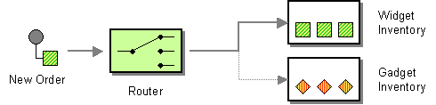
Content Based Router
http://www.enterpriseintegrationpatterns.com/patterns/messaging/ContentBasedRouter.html
Notes:
Assume that we are building an order processing system. When an incoming order is received, we first validate the order and then verify that the ordered item is available in the warehouse. This function is performed by the inventory system. This sequence of processing steps is a perfect candidate for the Pipes and Filters style. We create two filters, one for the validation step and one for the inventory system, and route the incoming messages through both filters. However, in many enterprise integration scenarios more than one inventory system exists with each system being able to handle only specific items.
How do we handle a situation where the implementation of a single logical function (e.g., inventory check) is spread across multiple physical systems?
Use a Content-Based Router to route each message to the correct recipient based on message content.
The Content-Based Router examines the message content and routes the message onto a different channel based on data contained in the message. The routing can be based on a number of criteria such as existence of fields, specific field values etc. When implementing a Content-Based Router, special caution should be taken to make the routing function easy to maintain as the router can become a point of frequent maintenance. In more sophisticated integration scenarios, the Content-Based Router can take on the form of a configurable rules engine that computes the destination channel based on a set of configurable rules.
Content Based Router: The Content-Based Router examines the message content and routes the message onto a different channel based on data contained in the message. The routing can be based on a number of criteria, such as existence of fields, specific field values, and so on. When implementing a Content-Based Router, special caution should be taken to make the routing function easy to maintain, as the router can become a point of frequent maintenance. In more sophisticated integration scenarios, the Content-Based Router can take on the form of a configurable rules engine that computes the destination channel based on a set of configurable rules.

Slide 101
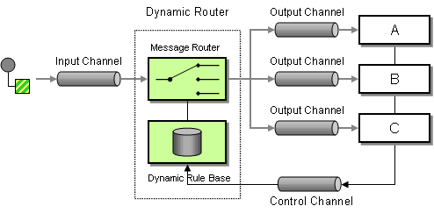
Dynamic Router
http://www.enterpriseintegrationpatterns.com/patterns/messaging/DynamicRouter.html
Notes:
You are using a Message Router to route messages between multiple destinations.
How can you avoid the dependency of the router on all possible destinations while maintaining its efficiency?
Use a Dynamic Router, a Router that can self-configure based on special configuration messages from participating destinations.
Besides the usual input and output channels the Dynamic Router uses an additional control channel. During system start-up, each potential recipient sends a special message to the Dynamic Router on this control channel, announcing its presence and listing the conditions under which it can handle a message. The Dynamic Router stores the 'preferences' for each participant in a rule base. When a message arrives, the Dynamic Router evaluates all rules and routes the message to the recipient whose rules are fulfilled. This allows for efficient, predictive routing without the maintenance dependency of the Dynamic Router on each potential recipient.
Dynamic Router: Besides the usual input and output channels, the Dynamic Router uses an additional control channel. During system startup, each potential recipient sends a special message to the Dynamic Router on this control channel, announcing its presence and listing the conditions under which it can handle a message. The Dynamic Router stores the preferences for each participant in a rule base. When a message arrives, the Dynamic Router evaluates all rules and routes the message to the recipient whose rules are fulfilled. This allows for efficient, predictive routing without the maintenance dependency of the Dynamic Router on each potential recipient. In the most basic scenario, each participant announces its existence and routing preferences to the Dynamic Router at startup time. This requires each participant to be aware of the control queue used by the Dynamic Router. It also requires the Dynamic Router to store the rules in a persistent way. Otherwise, if the Dynamic Router fails and has to restart, it would not be able to recover the routing rules. Alternatively, the Dynamic Router could send a broadcast message to all possible participants to trigger them to reply with the control message. This configuration is more robust but requires the use of an additional
Publish-Subscribe Channel.
A common use of the Dynamic Router is dynamic service discovery in service-oriented architectures. If a client application wants to access a service, it sends a message containing the name of the service to the Dynamic Router. The Dynamic Router maintains a service directory, a list of all services with their name and the channel they listen on. The router builds this directory based on control messages from each service provider. When a service request arrives, the Dynamic Router uses the service directory to look up the service by name, then routes the message to the correct channel. This setup allows the client application to send command messages to a single channel without having to worry about the nature or location of the specified service provider, even if the provider changes.

Slide 102
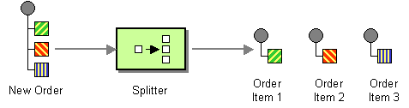
Splitter
http://www.enterpriseintegrationpatterns.com/patterns/messaging/Sequencer.html
Notes:
Many messages passing through an integration solution consist of multiple elements. For example, an order placed by a customer consists of more than just a single line item. As outlined in the description of the Content-Based Router, each line item may need to be handled by a different inventory system. Thus, we need to find an approach to process a complete order, but treat each order item contained in the order individually.
How can we process a message if it contains multiple elements, each of which may have to be processed in a different way?
Use a Splitter to break out the composite message into a series of individual messages, each containing data related to one item.
use a Splitter that consumes one message containing a list of repeating elements, each of which can be processed individually. The Splitter publishes a one message for each single element (or a subset of elements) from the original message.

Slide 103
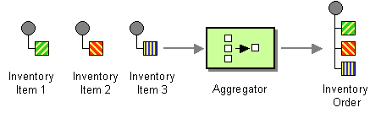
Aggregator
http://www.enterpriseintegrationpatterns.com/patterns/messaging/Aggregator.html
Notes:
A Splitter is useful to break out a single message into a sequence of sub-messages that can be processed individually. Likewise, a Recipient List or a Publish-Subscribe Channel is useful to forward a request message to multiple recipients in parallel in order to get multiple responses to choose from. In most of these scenarios, the further processing depends on successful processing of the sub-messages. For example, we want to select the best bid from a number of vendor responses or we want to bill the client for an order after all items have been pulled from the warehouse.
How do we combine the results of individual, but related messages so that they can be processed as a whole?
Use a stateful filter, an Aggregator, to collect and store individual messages until a complete set of related messages has been received. Then, the Aggregator publishes a single message distilled from the individual messages.
The Aggregator is a special Filter that receives a stream of messages and identifies messages that are correlated. Once a complete set of messages has been received (more on how to decide when a set is 'complete' below), the Aggregator collects information from each correlated message and publishes a single, aggregated message to the output channel for further processing.

Slide 104
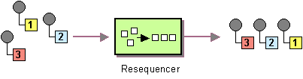
Resequencer
http://www.enterpriseintegrationpatterns.com/patterns/messaging/Resequencer.html
Notes:
A Message Router can route messages from one channel to different channels based on message content or other criteria. Because individual messages may follow different routes, some messages are likely to pass through the processing steps sooner than others, resulting in the messages getting out of order. However, some subsequent processing steps do require in-sequence processing of messages, for example to maintain referential integrity.
How can we get a stream of related but out-of-sequence messages back into the correct order?
Use a stateful filter, a Resequencer, to collect and re-order messages so that they can be published to the output channel in a specified order.
The Resequencer can receive a stream of messages that may not arrive in order. The Resequencer contains in internal buffer to store out-of-sequence messages until a complete sequence is obtained. The in-sequence messages are then published to the output channel. It is important that the output channel is order-preserving so messages are guaranteed to arrive in order at the next component. Like most other routers, a Resequencer usually does not modify the message contents.

Slide 105
2.5 Transformation

Slide 106
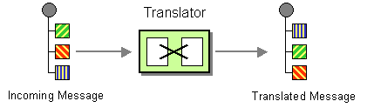
Message Translator
http://www.enterpriseintegrationpatterns.com/patterns/messaging/MessageTranslator.html
Notes:
The previous patterns describe how to construct messages and how to route them to the correct destination. In many cases, enterprise integration solutions route messages between existing applications such as legacy systems, packaged applications, homegrown custom applications, or applications operated by external partners. Each of these applications is usually built around a proprietary data model. Each application may have a slightly different notion of the Customer entity , the attributes that define a Customer and which other entities a Customer is related to. For example, the accounting system may be more interested in the customer's tax payer ID numbers while the customer-relationship management (CRM) system stores phone numbers and addresses. The application’s underlying data model usually drives the design of the physical database schema, an interface file format or a programming interface (API) -- those entities that an integration solution has to interface with. As a result, the applications expect to receive messages that mimic the application's internal data format.
In addition to the proprietary data models and data formats incorporated in the various applications, integration solutions often times interact with standardized data formats that seek to be independent from specific applications. There are a number of consortia and standards bodies that define these protocols, such as RosettaNet, ebXML, OAGIS and many other, industry specific consortia. In many cases, the integration solution needs to be able to communicate with external parties using the ‘official’ data formats while the internal systems are based on proprietary formats.
How can systems using different data formats communicate with each other using messaging?
Use a special filter, a Message Translator, between other filters or applications to translate one data format into another.
The Message Translator is the messaging equivalent of the Adapter pattern described in [GoF]. An adapter converts the interface of a component into a another interface so it can be used in a different context.

Slide 107
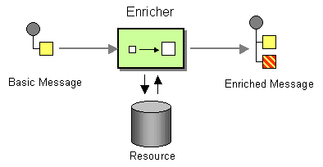
Content Enricher
http://www.enterpriseintegrationpatterns.com/patterns/messaging/DataEnricher.html
Notes:
When sending messages from one system to another it is common for the target system to require more information than the source system can provide. For example, incoming Address messages may just contain the ZIP code because the designers felt that storing a redundant state code would be superfluous. Likely, another system is going to want to specify both a state code and a ZIP code field. Yet another system may not actually use state codes, but spell the state name out because it uses free-form addresses in order to support international addresses. Likewise, one system may provide us with a customer ID, but the receiving system actually requires the customer name and address. An order message sent by the order management system may just contain an order number, but we need to find the customer ID associated with that order, so we can pass it to the customer management system. The scenarios are plentiful.
How do we communicate with another system if the message originator does not have all the required data items available?
Use a specialized transformer, a Content Enricher, to access an external data source in order to augment a message with missing information.
The Content Enricher uses information inside the incoming message (e.g. key fields) to retrieve data from an external source. After the Content Enricher retrieves the required data from the resource, it appends the data to the message. The original information from the incoming message may be carried over into the resulting message or may no longer be needed, depending on the specific needs of the receiving application.

Slide 108
2.6 Management

Slide 109
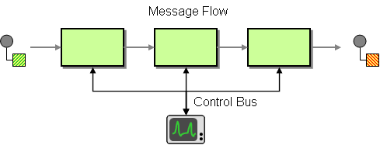
Control Bus
http://www.enterpriseintegrationpatterns.com/patterns/messaging/ControlBus.html
Notes:
How can we effectively administer a messaging system that is distributed across multiple platforms and a wide geographic area?
Use a Control Bus to manage an enterprise integration system. The Control Bus uses the same messaging mechanism used by the application data, but uses separate channels to transmit data that is relevant to the management of components involved in the message flow.
Each component in the system is now connected to two messaging subsystems:

Slide 110
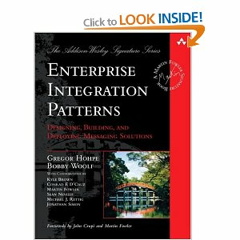
Further Reading

Slide 111
Q&A

